Slide 1

IP3
Week 6 Wireframe
Andrew McNicol
Zoltán Tompa
Nicholas Metcalfe
Mark Jeffrey
Joshua Jahanshir
Dale Fraser
Ray Robertson

Slide 2
Recap
:What have we changed since week 3?
:What did we remove?
:What did we add?

Slide 3
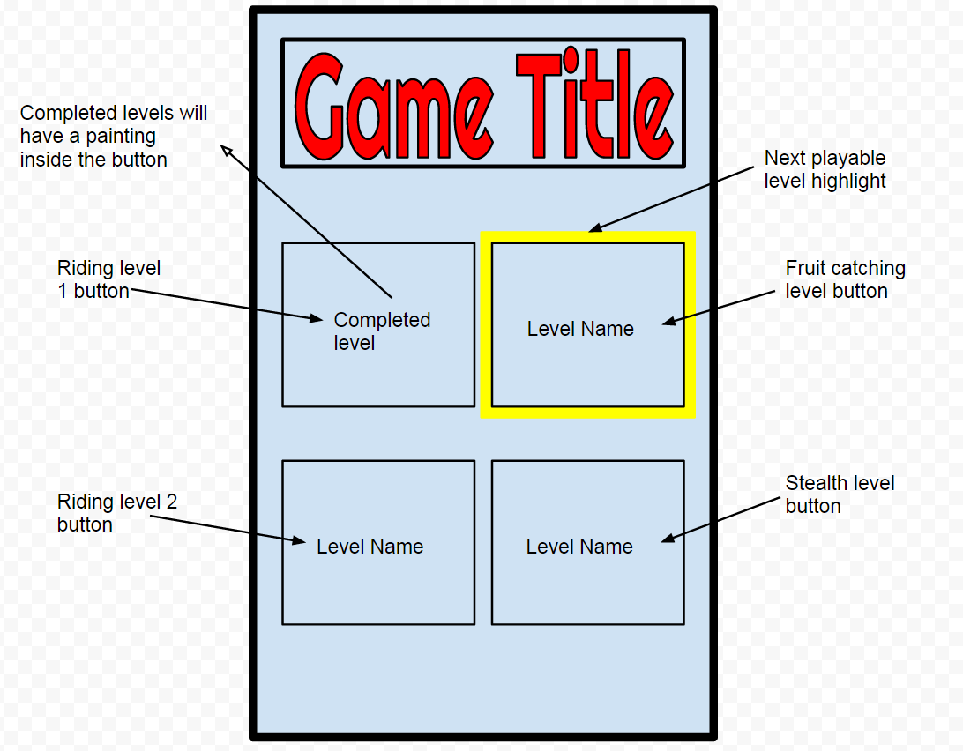
The Main Hub
What is the main hub?
How does it link the games?
How will the player learn how to play the games?

Slide 4
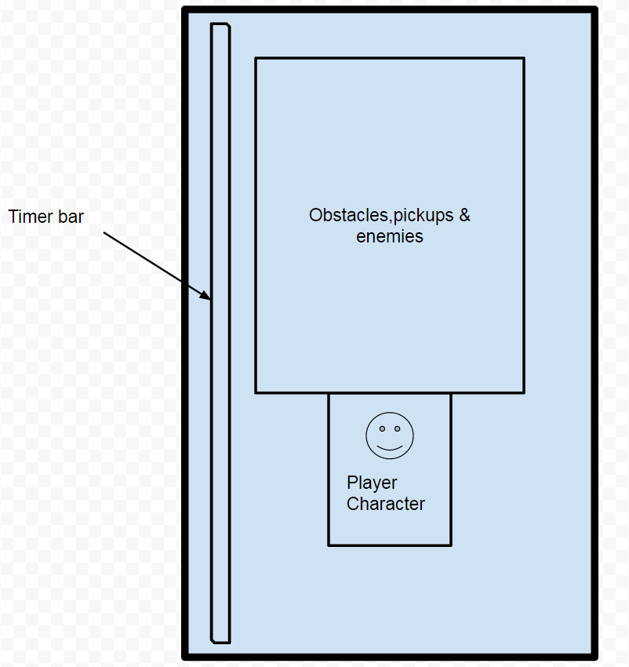
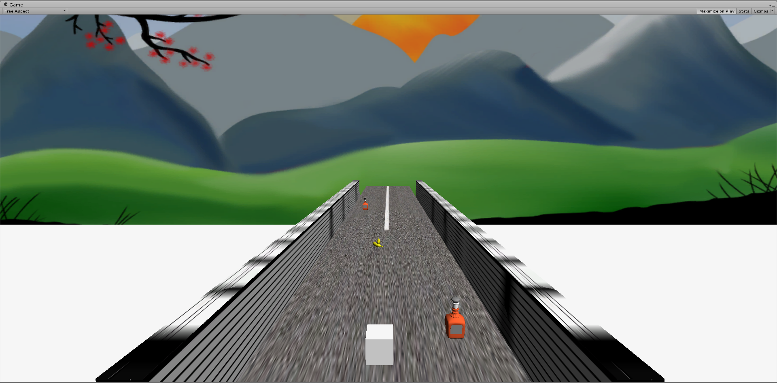
Level 1: Horse Riding
How do you play?
What are the win conditions?
What art assets are needed?

Slide 5
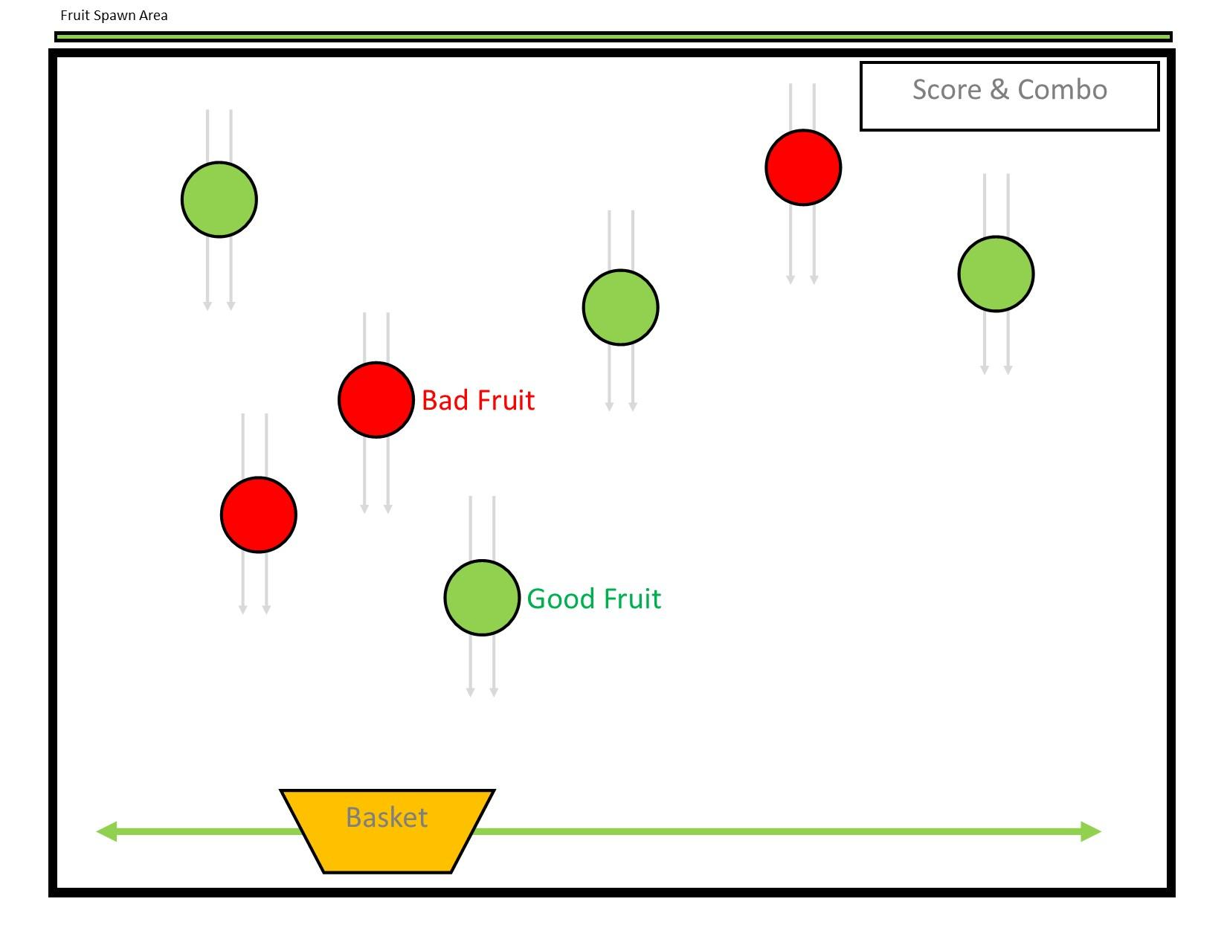
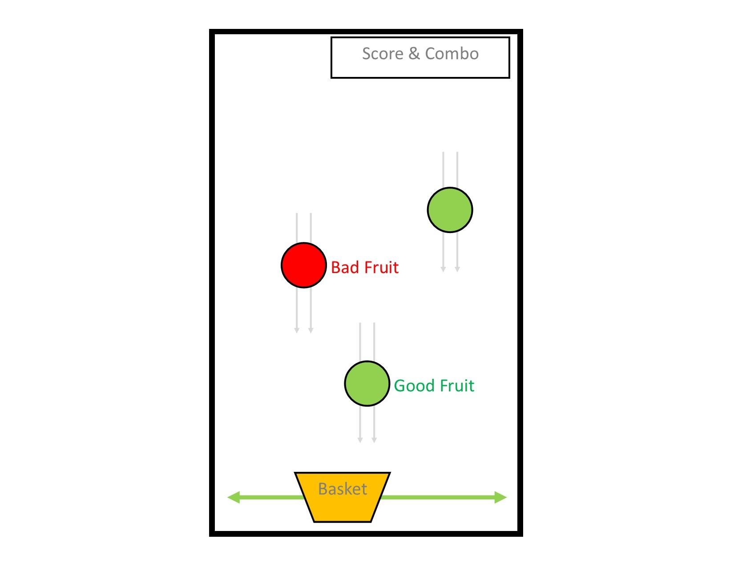
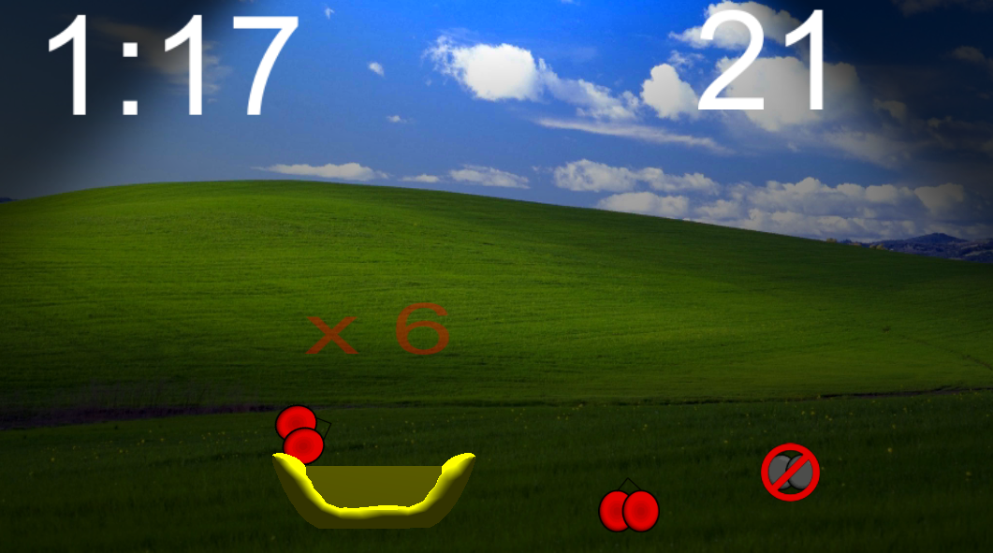
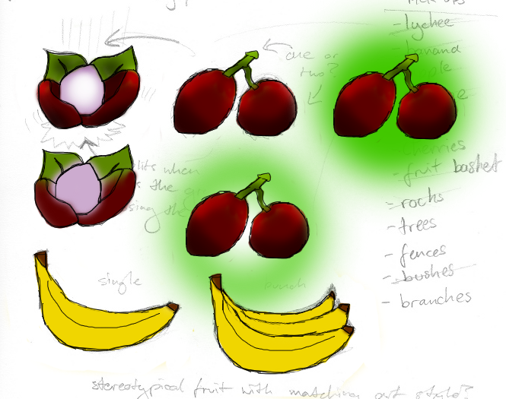
Level 2: Fruit Collecting
What is the aim of the game?
Good fruit (Lychee) & Bad fruit (Not Lychee)
Combo meter and score system

Slide 6
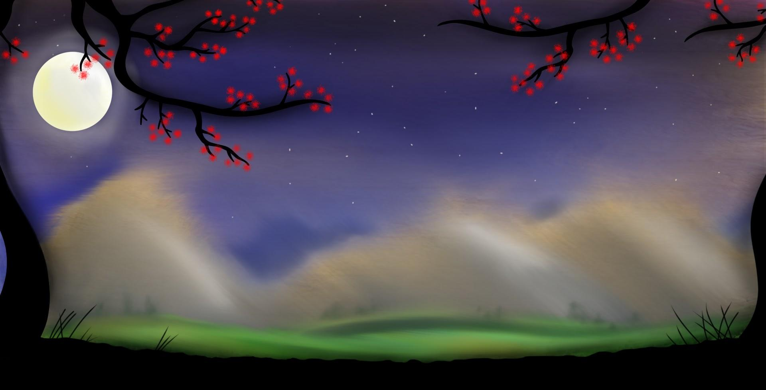
Level 3: Horse Riding (Part 2)
: Same idea as level 1
:Level will be at night time as Lady Yang returns

Slide 7
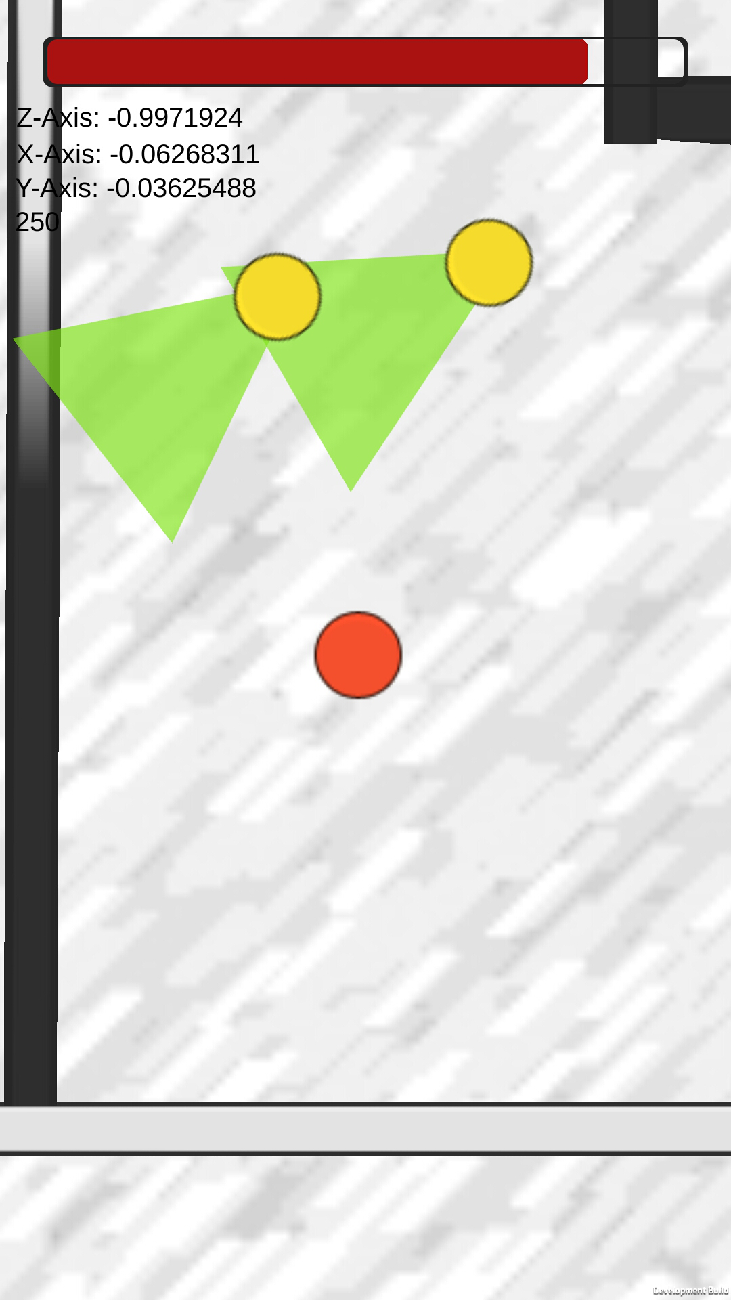
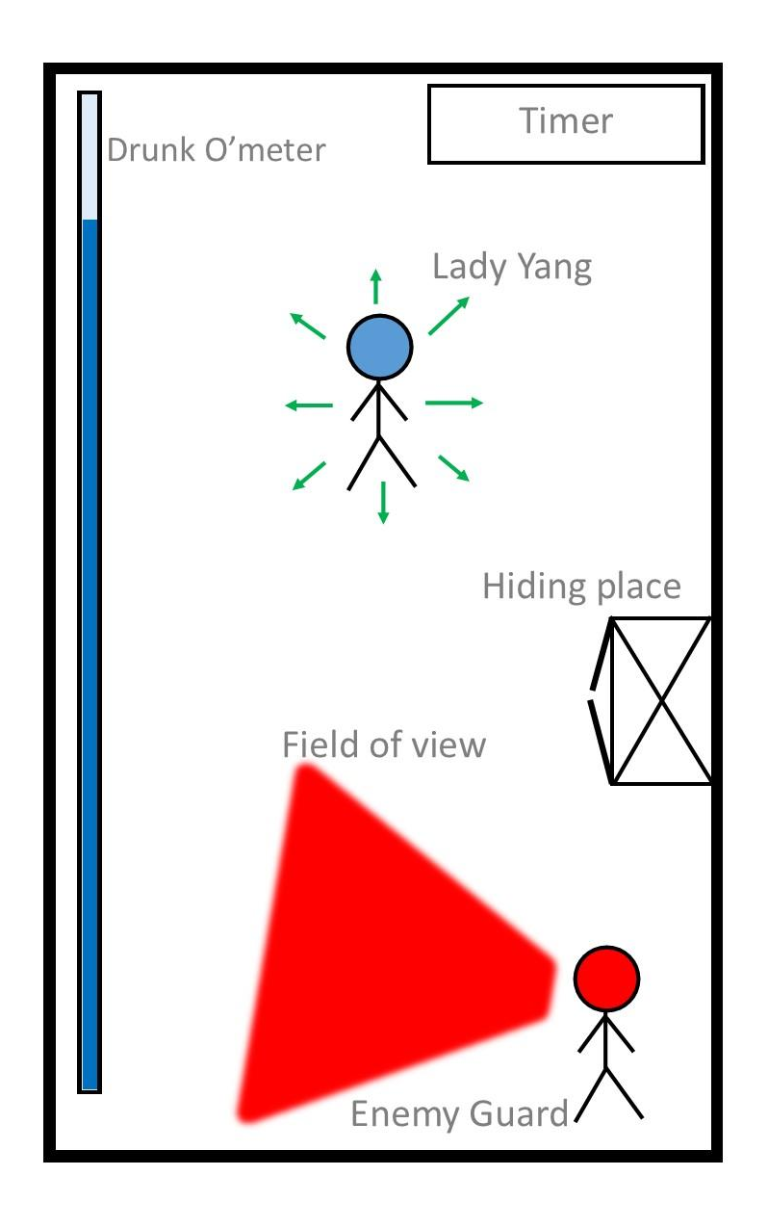
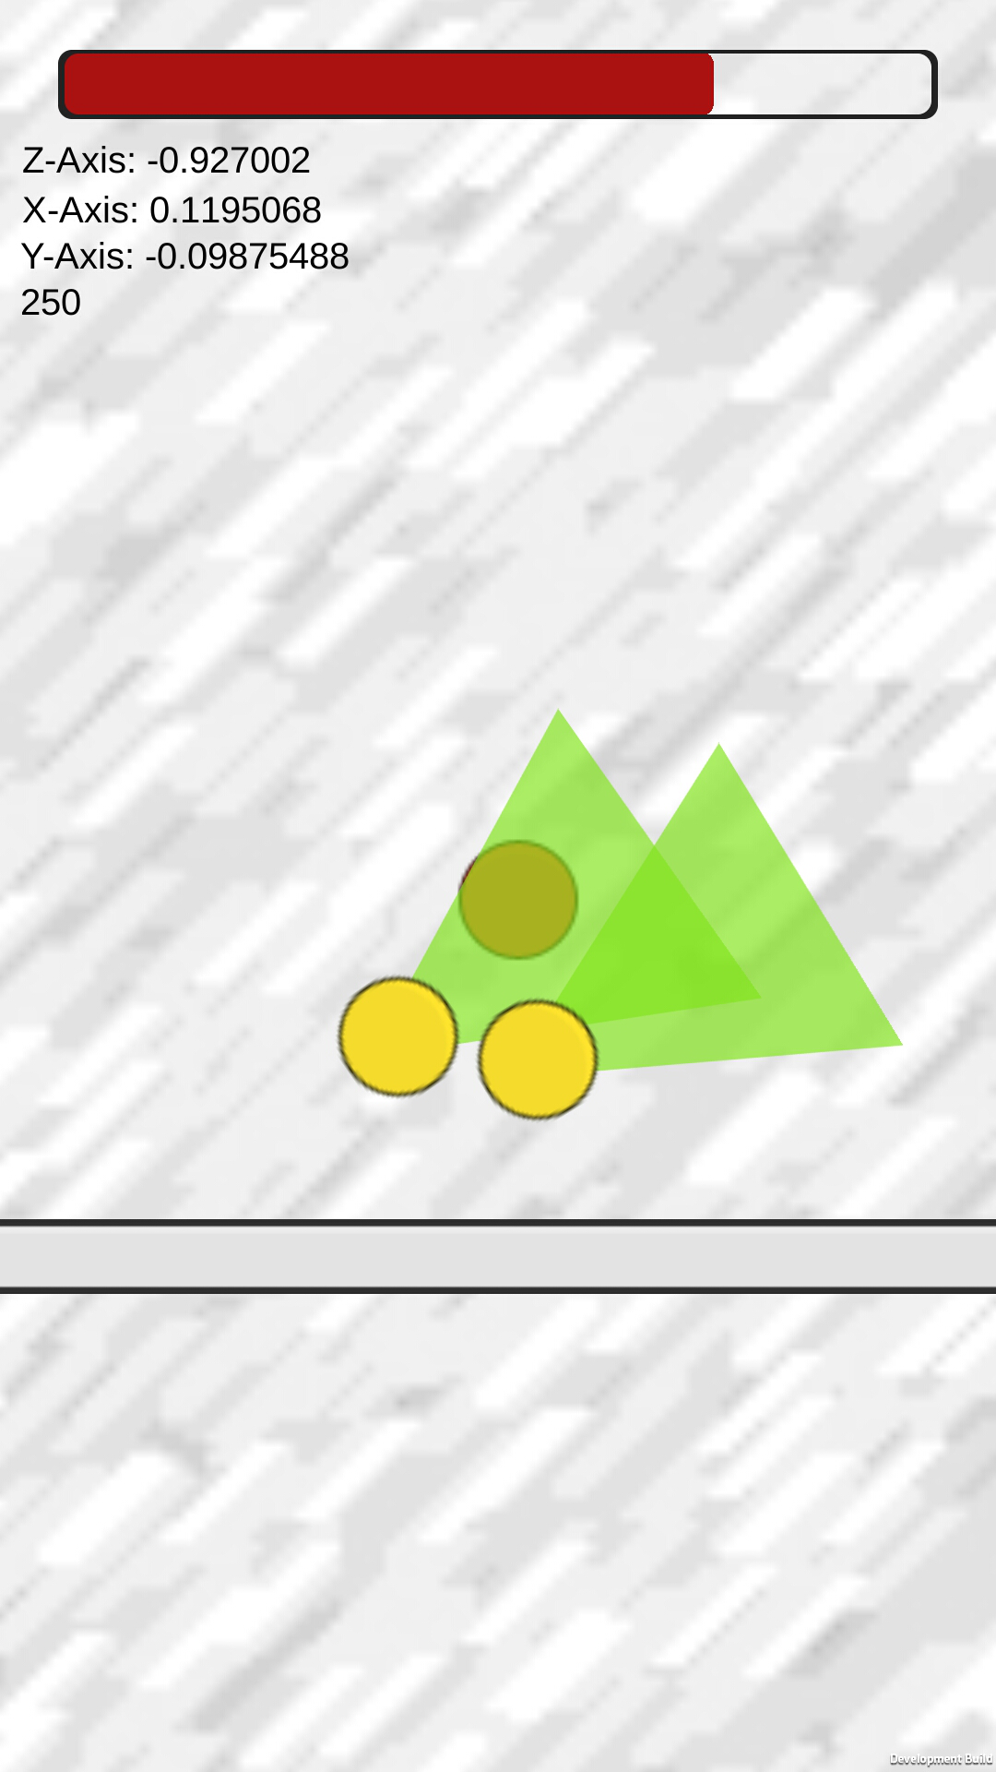
Level 4: One Too Many
Changes since week 3
What has been implemented so far

Slide 8
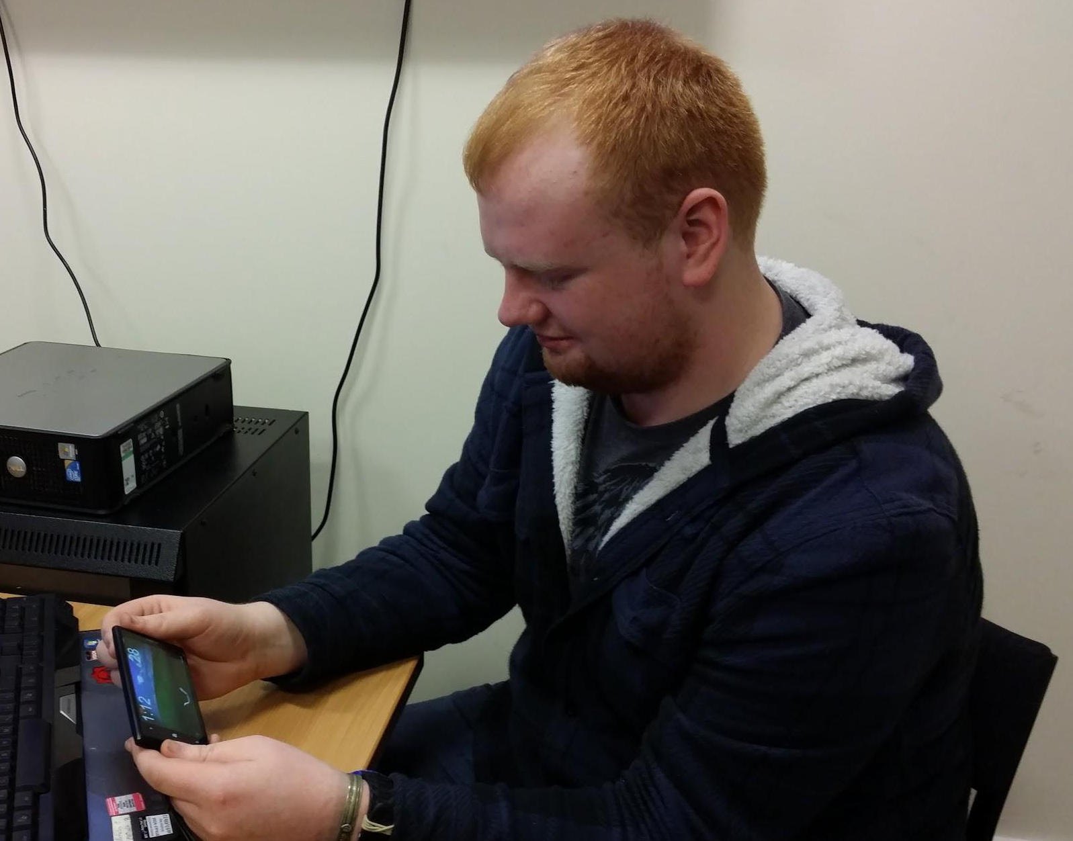
Playtesting
User Evaluation - playtest week 7
Multi-platform playtest
Observation
Followed up by a questionnaire
Mixed qualitative and quantitative questions
Focus on:
Clarity
Fun
Simple difficulty
Controls
Expert playtesting ongoing

Slide 9
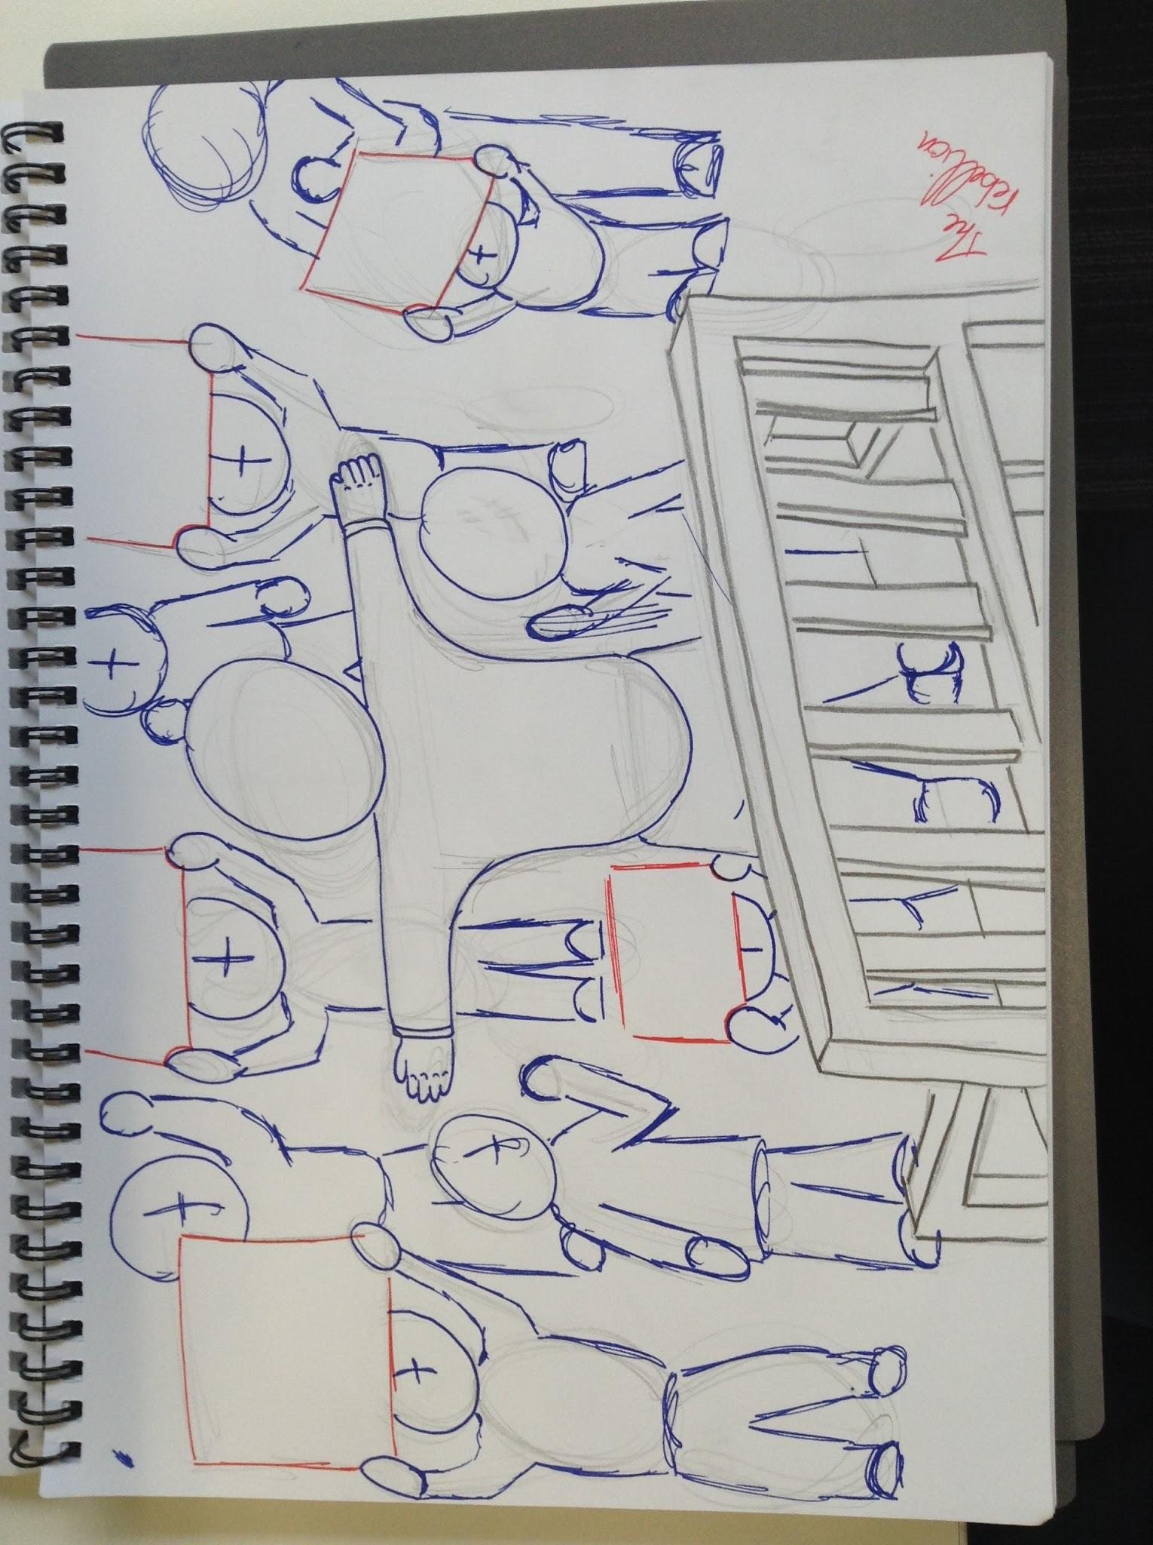
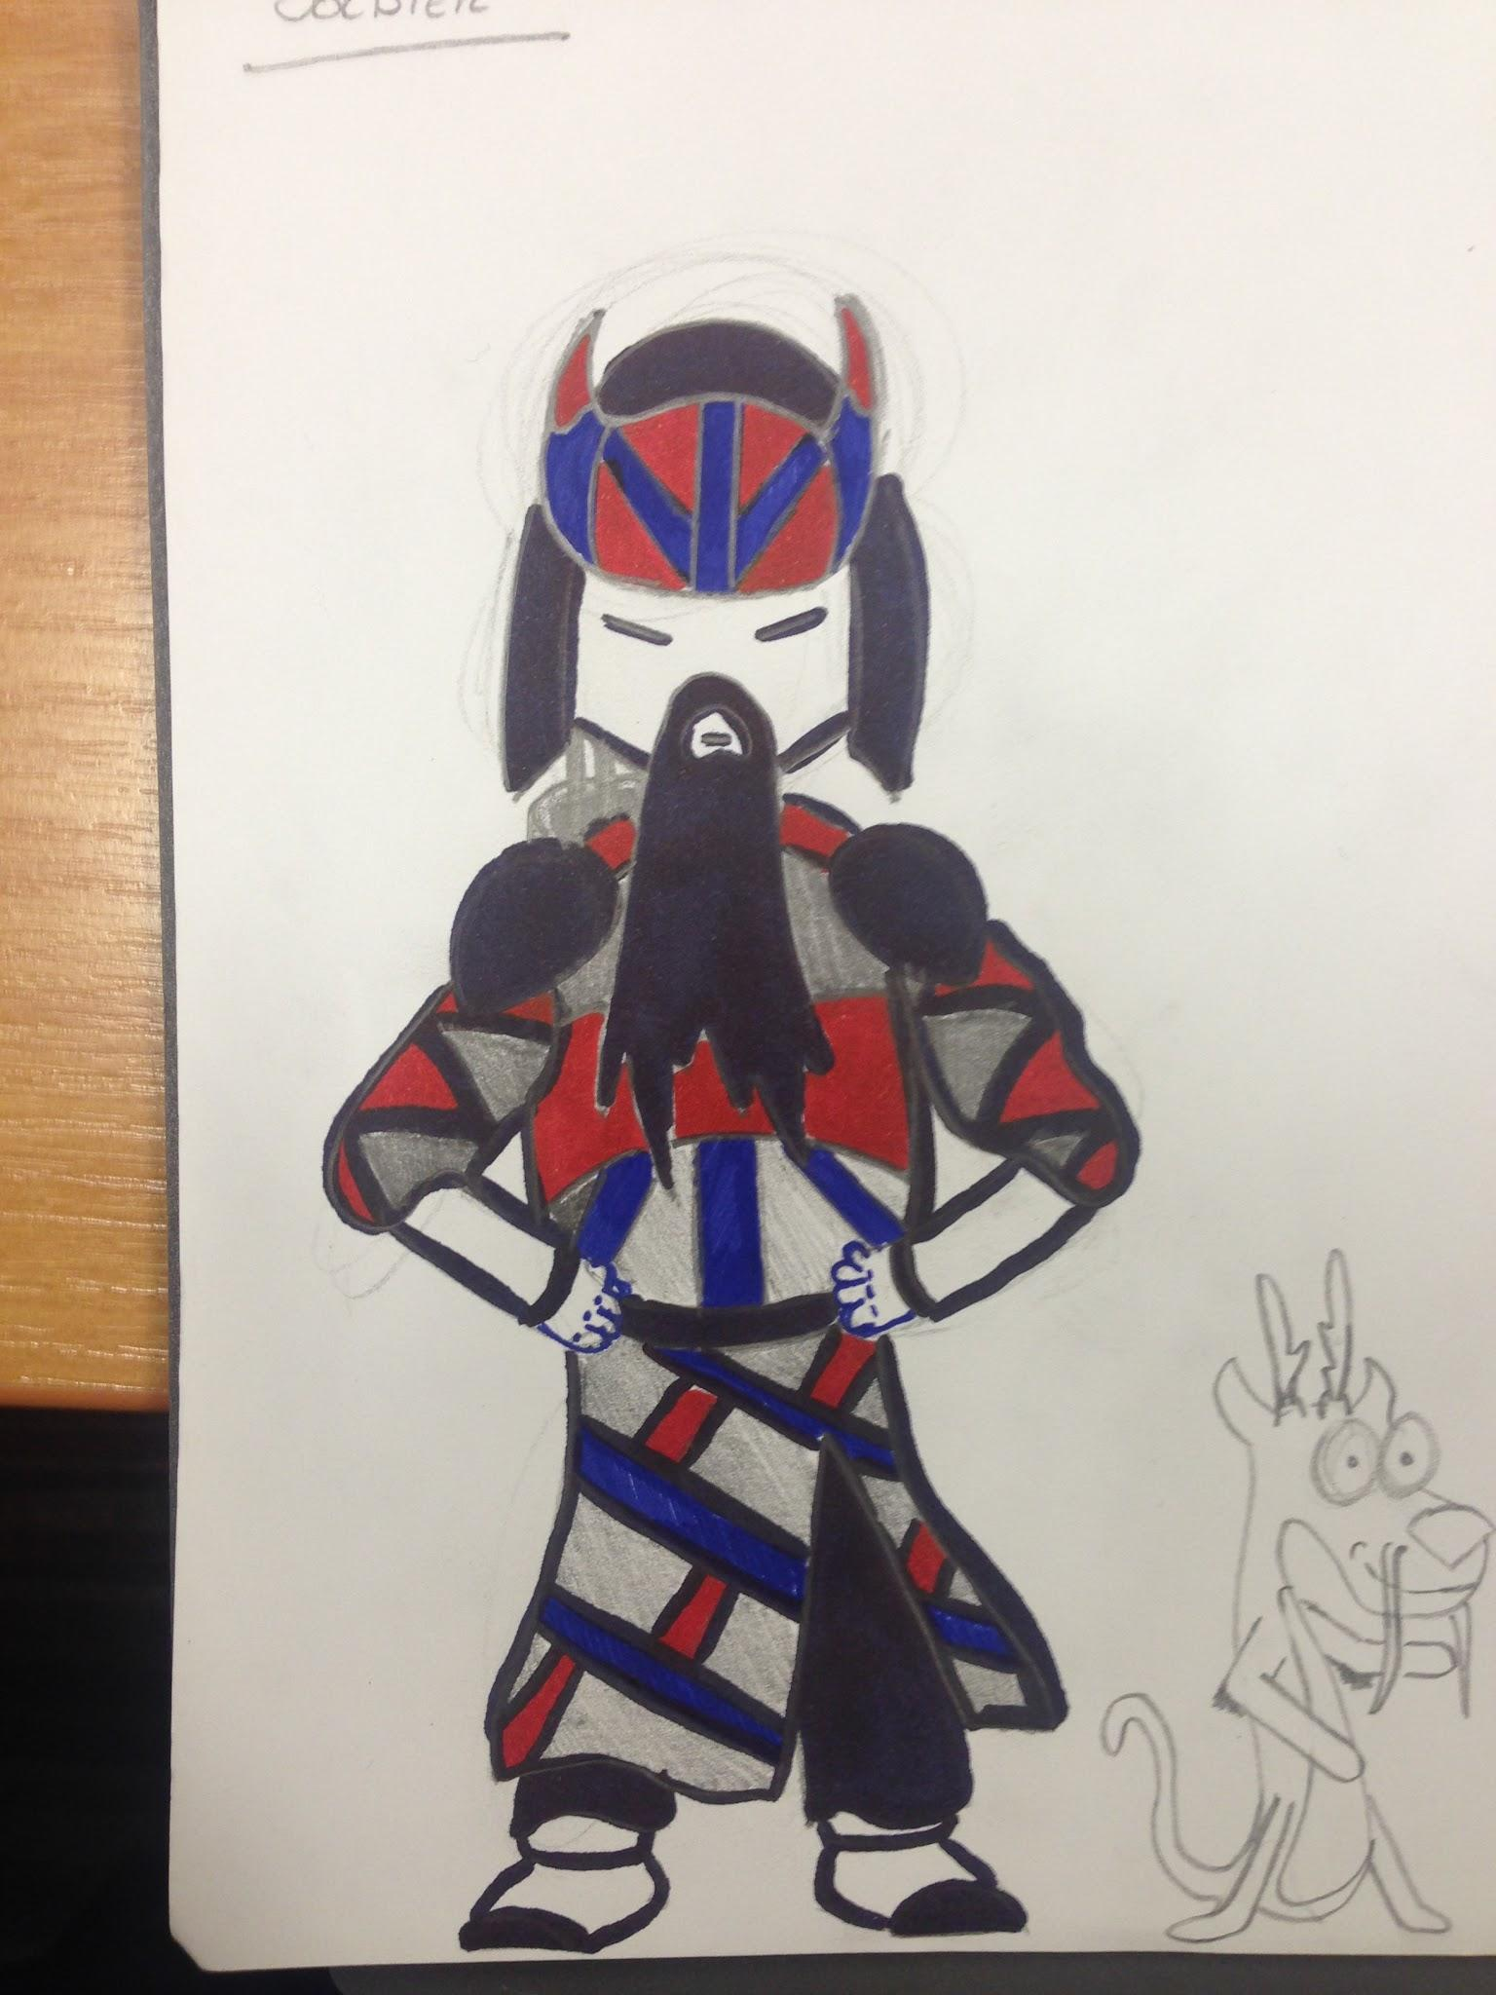
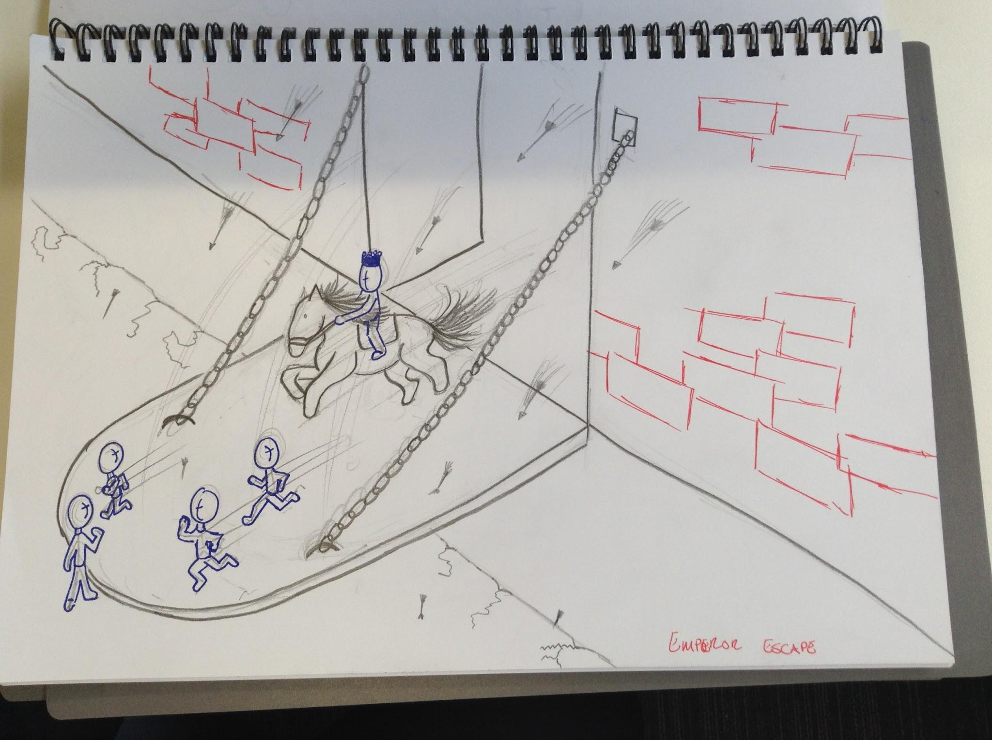
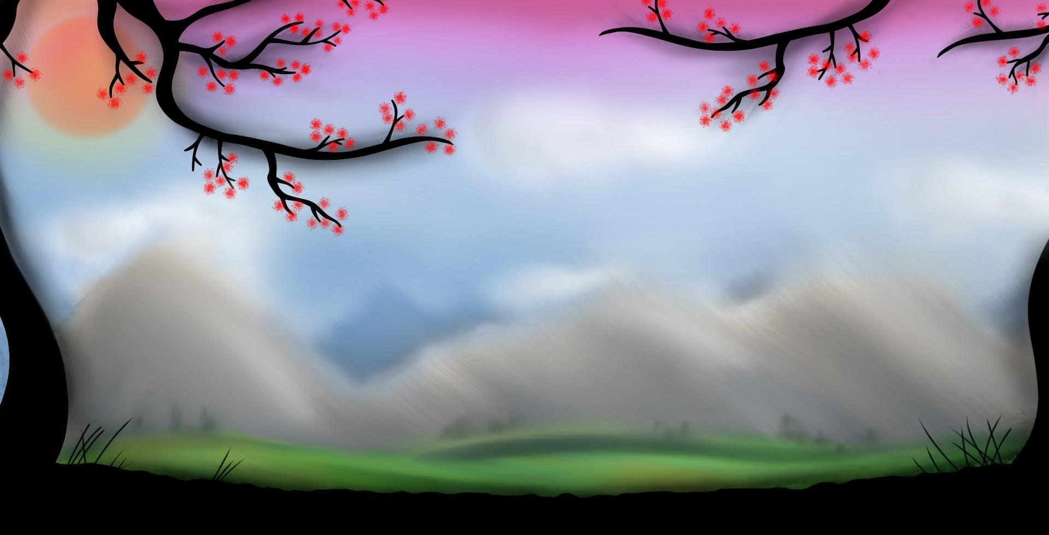
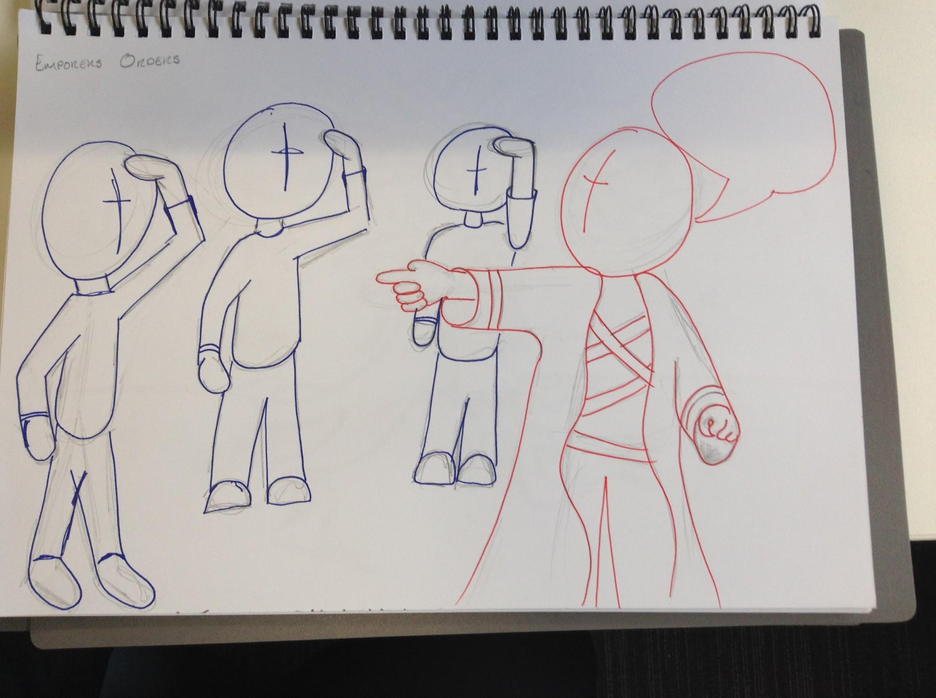
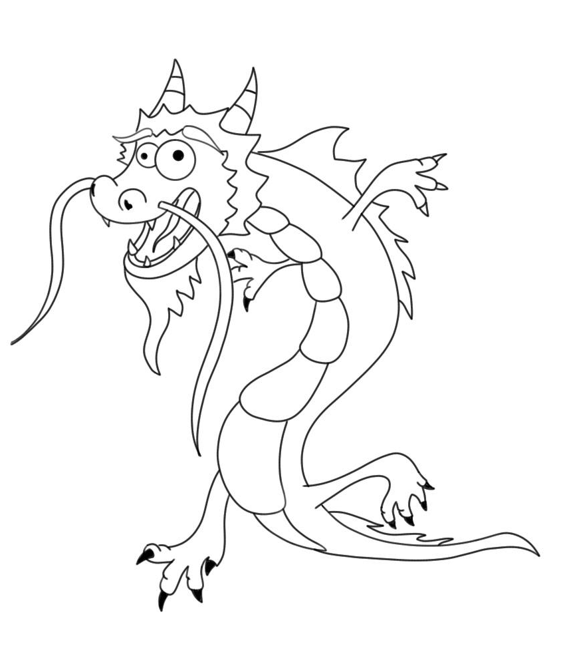
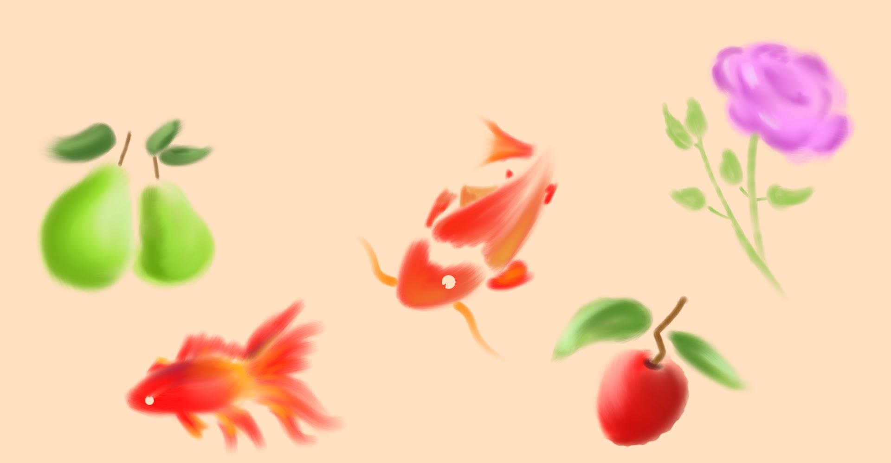
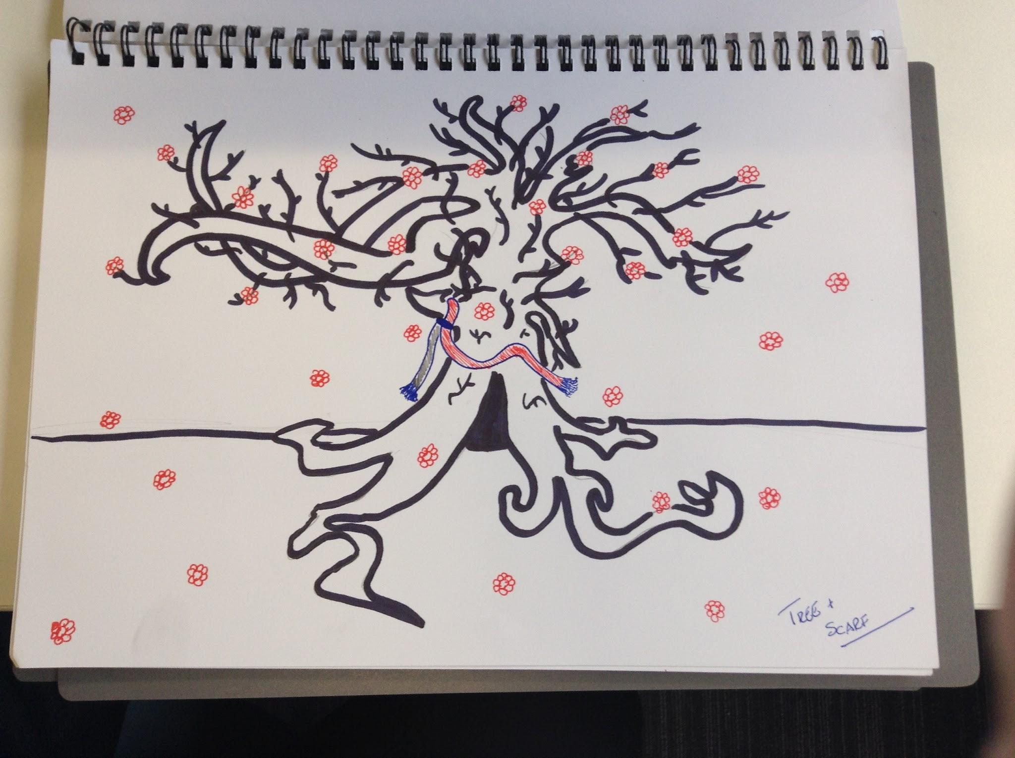
Art Style Concepts

Slide 10
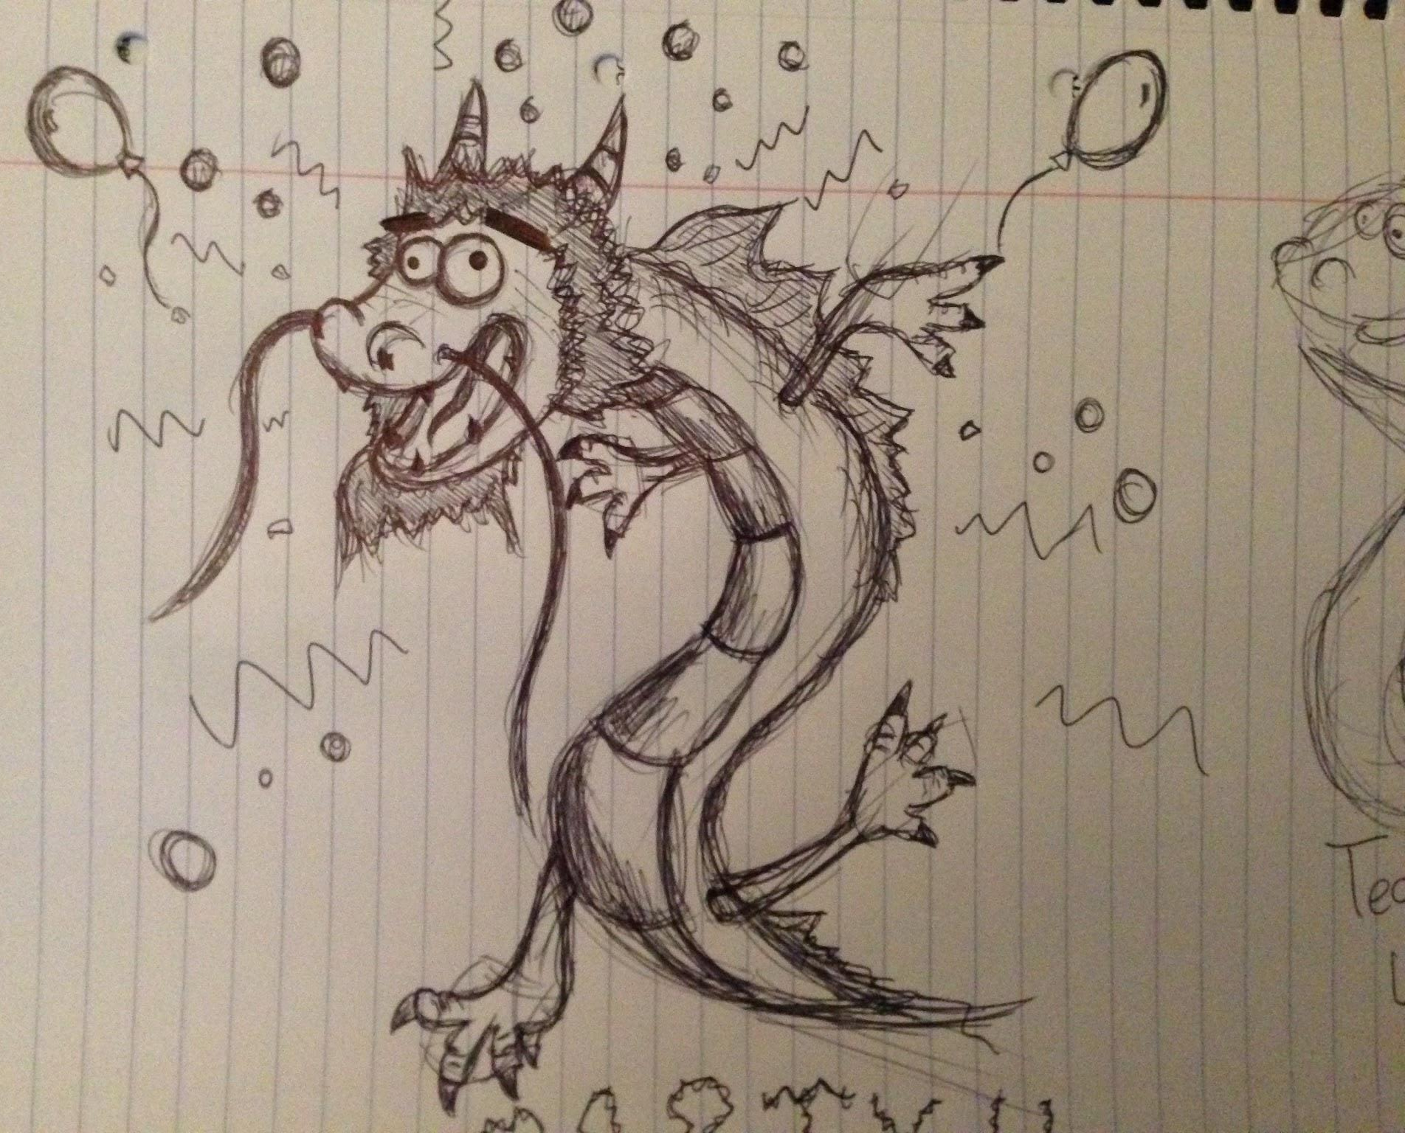
Thank You For Listening

